Slide 1
Data leading the way: Designing responses and policy changed based on the numbers Reaching young women and girls through comprehensive responses July 23, 2019 Ambassador Deborah Birx, MD U.S. Global AIDS Coordinator

Slide 2
Self Assessment of how we are doing globally :
Note : there are many countries with strong health systems and strong primary care with less than 15% treatment and prevention services coverage.
We have to address the structural barriers to access

Slide 3
Impact on key population epidemics - F
Comprehensive programming requires parallel programming for men and boys to recognize and address their unique needs - C
Comprehensive prevention for young men through VMMC – B+
Comprehensive early treatment and viral load suppression for men and boys and young women – C-
Retaining young people on treatment - D
Universal access to condoms – C

Slide 4
PEPFAR has now supported
over 20 Million VMMCs
Voluntary medical male circumcision (VMMC) PEPFAR supported Over 20 Million men in receiving VMMC through March 2019

Slide 5
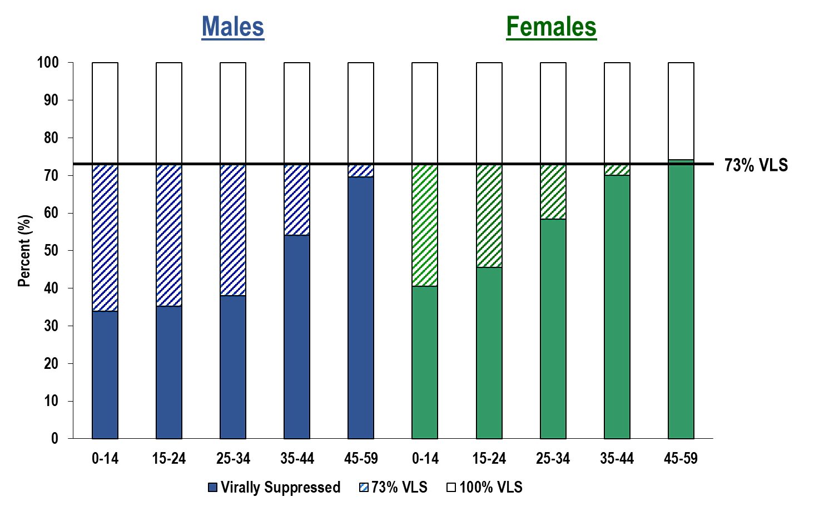
Key Gaps (children, young men 15-34 and young women 15-24) in Reaching Specific Populations Community Viral Load Suppression By Age and Gender
*Pooled data from Lesotho, Malawi, Namibia, Swaziland, Tanzania, Uganda, Zambia, and Zimbabwe from PHIA projects.

Slide 6
Namibia HIV + Population “Pyramid” who are we missing and why
35%
40%
40%
15%
20%
Male
Female
Namibia is now estimated to be at 94-96-95

Slide 7
KEY Programmatic implemention GAP: Prevention and treatment Services for Young Men AND Adolescent Girls & Young Women
DREAMS
Tx
Girls and
Young Women
Well HIV +
Young Men
25-35 yo
9-24 yo
HIV
HIV
Uninfected
Young Men
VMMC Condoms
PrEP
15-30 yo

Slide 8
DREAMS and DATA
DREAMS is a structural and now addition of PrEP comprehensive program of primary prevention
Notes:
What have we learned so far?

Slide 9
Notes:
WHERE for DREAMS??
Took prevalence & # cases into consideration to choose countries

Slide 10
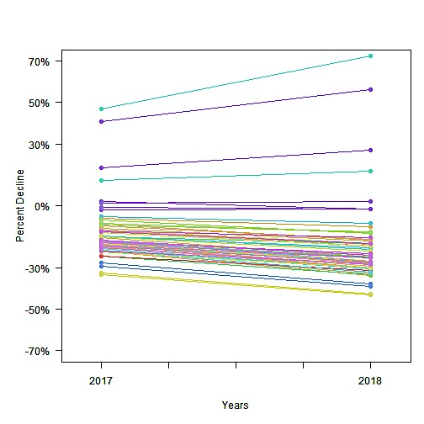
Data as a Key Resource in Every Phase of DREAMS
Establish Need
Identify issues
Identify Interventions
Monitor Implementation
Evaluate Impact
Program Improvement
Identify vulnerable AGYW
Listen to and include the AGYM
Prevent early sexual violence
Ensure all girls are in school
Community and Family Support
Access to health services
Access to biomedical interventions
Girl Roster

Slide 11
The DREAMS Partnership
Announced on World AIDS Day 2014
$300 million partnership (originally 2015-2016)
Partners include PEPFAR, Bill & Melinda Gates Foundation, Gilead Sciences, Girl Effect, Johnson & Johnson, ViiV Healthcare
$85 million for the DREAMS Innovation Challenge
$188.9 million in COP 17 funds, $190.4 million in COP 18 funds, and $190.4 million in planned COP 19 funds for DREAMS activities
15 countries in Africa and the Caribbean
TOTAL: Almost $905 million of direct DREAMS funding over 5 years
Funding to scale up VMMC and test & start for young adult men ($1.5 B over the same time period)
Integration with OVC program to ensure early services ($1 B over the same time period)
Ensuring access to testing and HIV treatment ($3 Billion over the same 5 years)

Slide 12
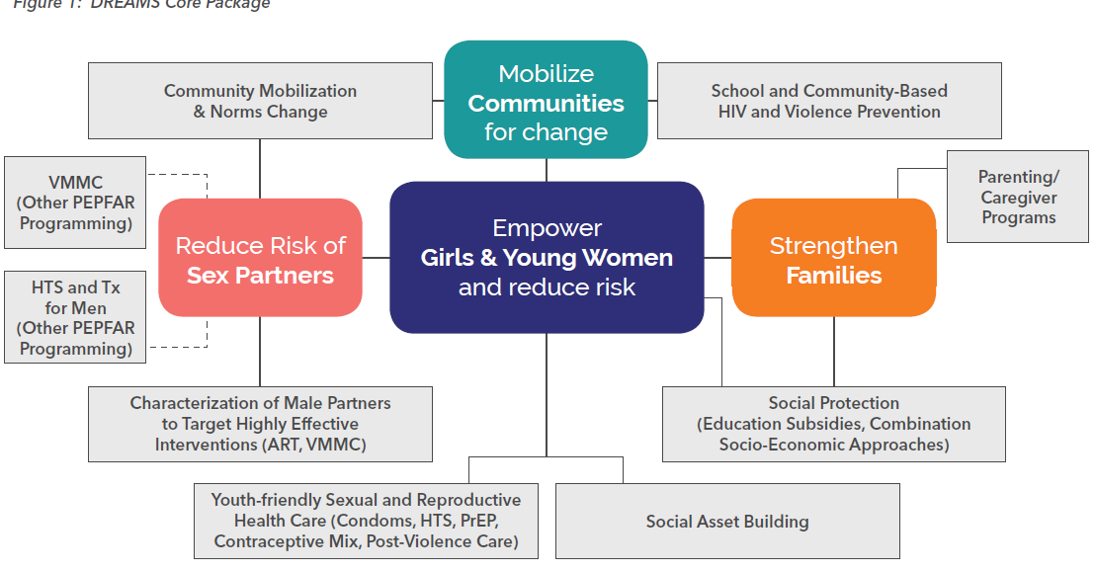
DREAMS Core Package
COP Activities
Notes:
Talking points:
Some points about the program that have to be taken into consideration as we look at data on DREAMS…
DREAMS involves a COMPREHENSIVE package of programs and services ; these differ by:
Country (little variation across countries; PrEP is the component that some still do not have)
District (little variation across districts within a country)
Age group
Individual needs (not all AGYW need post violence care; AGYW not sexually active don’t need condoms)
DREAMS does not exist in a vacuum
Broader PEPFAR programming
Not just for AGYW, but also for men who are likely to be the sex partners of AGYW
if we decrease the risk of young adult men with our other programming, we reduce risk for AGYW

Slide 13
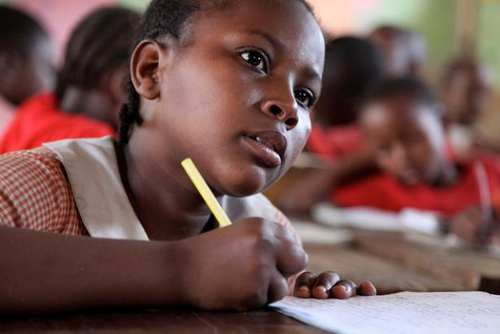
Our Priorities for Adolescent Girls and Young Women
Keep them HIV FREE
Support them to:
Stay in school
Prevent early pregnancies
Prevent sexual violence
Post violence care
Reduce child marriage
Photo credit: USAID/Carole Douglis

Slide 14
DREAMS Findings
Notes:
What have we learned so far?

Slide 15
Changes in DREAMS Districts Reported on World AIDS Day, 2018
In 2017, the majority (>60%) of DREAMS districts showed a decline in new HIV diagnoses among AGYW attending ANC clinics.
In 2018, new diagnoses among AGYW continued to decline in 85% of these communities/districts implementing DREAMS.
Eight DREAMS-supported districts progressed from a less than a 25% decline in new HIV diagnoses among AGYW in 2017 to a greater than 25% decline in 2018 (including communities in Lesotho & South Africa).

Slide 16
Districts With >25 % Declines
2015-2018 Preliminary Data
Note: S/GAC is finalizing data. Zimbabwe not included here.
Notes:
WADS 2018 data showing DREAMS districts that had >25% declines in new diagnoses among AGYW in ANC from 2016 to 2018
We are finalizing the data, including Zimbabwe data which is not included in the preliminary results here.

Slide 17
Districts With <25% Declines
2015-2018 Preliminary Data
Note: S/GAC is finalizing data. Zimbabwe not included here.
Notes:
WADS 2018 data showing DREAMS districts that had <25% declines in new diagnoses among AGYW in ANC from 2016 to 2018

Slide 18
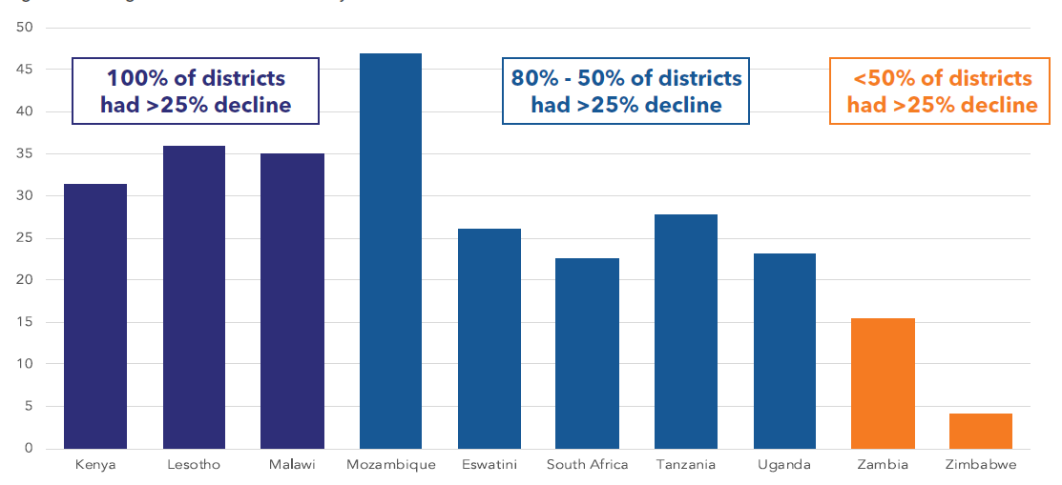
Average Percent Decline in DREAMS Districts 2015-2018 Preliminary Data
Note: S/GAC is finalizing data.

Slide 19
PrEP Expansion
Notes:
As you all know, DREAMS started out as a central initiative in 10 countries. We have all worked over the last 2 years to integrate DREAMS planning into the COP planning process, resulting in the institutionalization of prevention for AGYW into our annual planning, And last year, we expanded from 10 countries to 15.
This means that over 4 years, PEPFAR has invested over $760M in DREAMS.
So the investment has continued, and the programming has evolved… When PEPFAR announced DREAMS on WAD in 2014, including PrEP in the core package for AGYW was pushing the envelope a bit. No one was doing this as part of a big programmatic effort – we were still in the world of small demonstration projects. But 5 of our 10 countries jumped right in, including it in their DREAMS plans from the beginning. Our teams have been working diligently with partner governments to establish policies and procedures for rolling out PrEP for AGYW and other populations and that work has paid off. We now have 11 DREAMS countries implementing PrEP and the rest on the cusp of doing so.

Slide 20
DREAMS – South Africa

Slide 21
South Africa
Two DREAMS-supported districts in South Africa (City of Johannesburg, Ekurhuleni progressed from a less than a 25% decline in new HIV diagnoses among AGYW in 2017 to a greater than 25% decline in 2018.

Slide 22
The Evolution of DREAMS
Notes:
What have we learned so far?

Slide 23
Data-Driven Evolution of DREAMS
PEPFAR and our partners are routinely monitoring programs, analyzing data, and consulting experts and stakeholders to improve DREAMS programming to:
Find efficiencies in the DREAMS core package
Fill programmatic gaps/make program improvements – bridge to employment and urban young women
Examples of data sources:
Program data through MER
Country narratives
Population Council implementation research
Modeling data on new diagnoses in ANC settings
Observations on implementation from site visits to 10 original countries
Notes:
In addition to the quantitative data we ae collecting, we traveled to all of the DREAMS countries to explore what might be contributing to differences between districts, and what lessons we are learning about how to implement this compled program
The purpose of these TDYs was to observe DREAMS implementation, in detail.
Approach:
Not a formal qualitative study, HOWEVER, approaching in systematic way…
Consistent set of questions for every visit (correspond to 2nd set of bullets on the slide)
Observations recorded, by district into spreadsheet, will look for patterns across districts and by WAD results (where possible);

Slide 24
Conclusions & Actions from DREAMS Findings/Observations
Gaps in layering and reliance on passive referrals and few can document their progress quantitatively (site visit observations, program narratives, program MER data)
ACTION TAKEN → New MER indicator as a requirement that will require teams to have systems that track layering for unique AGYW.
ACTION TAKEN → COP19 guidance recommends teams to focus on active linkages rather than passive referrals between components of the core package, and to co-locate some DREAMS services when possible

Slide 25
Conclusions & Actions from DREAMS Findings/Observations
AGYW largely dependent on transactional sex to meet needs (Population Council Implementation data, site visit observations)
ACTION TAKEN→ working with PEPFAR teams to encourage implementation of more evidence-based income generating activities that support a living wage
FUTURE ACTION→ following up with economic experts, private sector, and country teams to explore bridge to employment and more sustainable economic opportunities

Slide 26
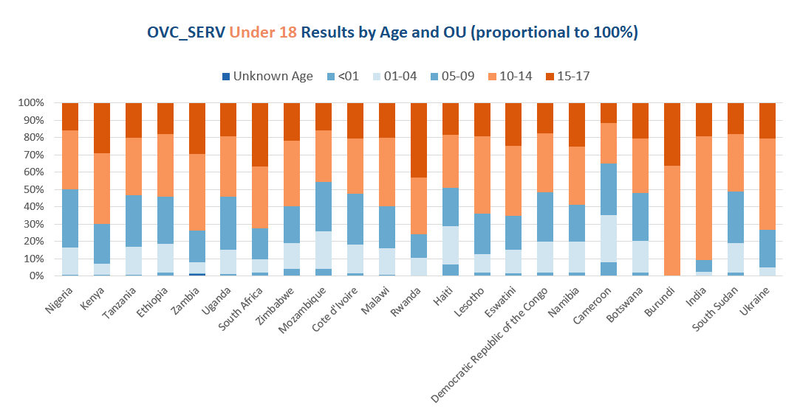
Evolution of PEPFAR’s Orphan’s and Vulnerable Children (OVC) programs are increasingly serving adolescents
Source: PEPFAR MER FY19Q2 Data, OVC_SERV

Slide 27
Ensuring Justice for Children
Preventing Gender Based Violence in girls
Notes:
What can we do about this?
I am going to talk about primary prevention of sexual violence and HIV → by primary prevention, I mean stopping these risks from ever happening
Because risk starts so early, that means that we need to focus on pre- and early adolescents so we can intervene before these things happen to youth

Slide 28
Forced or coerced sex at sexual initiation among females and males ages 13-24

Slide 29
Justice for Children -- Goals
Prevent perpetration of sexual violence against children
Protect children served by PEPFAR against sexual violence while taking part in PEPFAR funded programs and services (child safeguarding policies)
Facilitate disclosure, reporting, and appropriate system responses to cases of sexual violence against children, with a focus on holding perpetrators accountable

Slide 30
Meeting the needs of children, adolescents and young women with HIV
Notes:
What can we do about this?
I am going to talk about primary prevention of sexual violence and HIV → by primary prevention, I mean stopping these risks from ever happening
Because risk starts so early, that means that we need to focus on pre- and early adolescents so we can intervene before these things happen to youth

Slide 31
PEPFAR’s Comprehensive and integrated approach to lifecycles
Young HIV Affected Families, including teen moms
Index testing of all children of HIV+ moms
Pregnancy & infancy
HIV-exposed infants
DREAMS
Youth at risk of, and living with HIV
Adolescence & Youth
Childhood
“Well” Children (infected but not in care)
Boys & girls aged 9-14
Justice for child survivors of sexual violence

Slide 32
PEPFAR is Supported Treatment for Women and Girls (10-29 YO) 2,024,303

Slide 33
Investment in preventing Cervical Cancer Budgets, COP18 and COP19

Slide 34
Women Screened by Age
*PEPFAR MER FY19 Q2

Slide 35
Women Treated by Age
PEPFAR MER FY19 Q2

Slide 36
Types of Treatments Used
PEPRFAR MER FY19 Q2 Initial release

Slide 37
PEPFAR invests ~$2 billion this year in supporting women and girls
PEPFAR empowers and protects women and girls across their entire life cycle.
PEPFAR supports HIV treatment for 9.3 million women and girls*
The DREAMS Partnership has reduced new HIV diagnoses among adolescent girls and young women by over 25% in the majority of its intervention regions; 85% of these regions showed additional declines in 2018
PEPFAR supports 2 million female orphans and vulnerable children ages 0-17 years so they can survive and thrive*
PEPFAR has enabled over 2.4 million babies to be born HIV-free to HIV-positive mothers and kept these mothers alive with treatment**
PEPFAR is investing $30 million to reduce cervical cancer incidence by 95% among the roughly 3.5 million women living with HIV in eight African countries.
Through March 30, 2019
** Through September 30, 2018

Slide 38
Data collection and analysis is only valuable if its used to continuous improve program implementations and to change policy

Slide 39
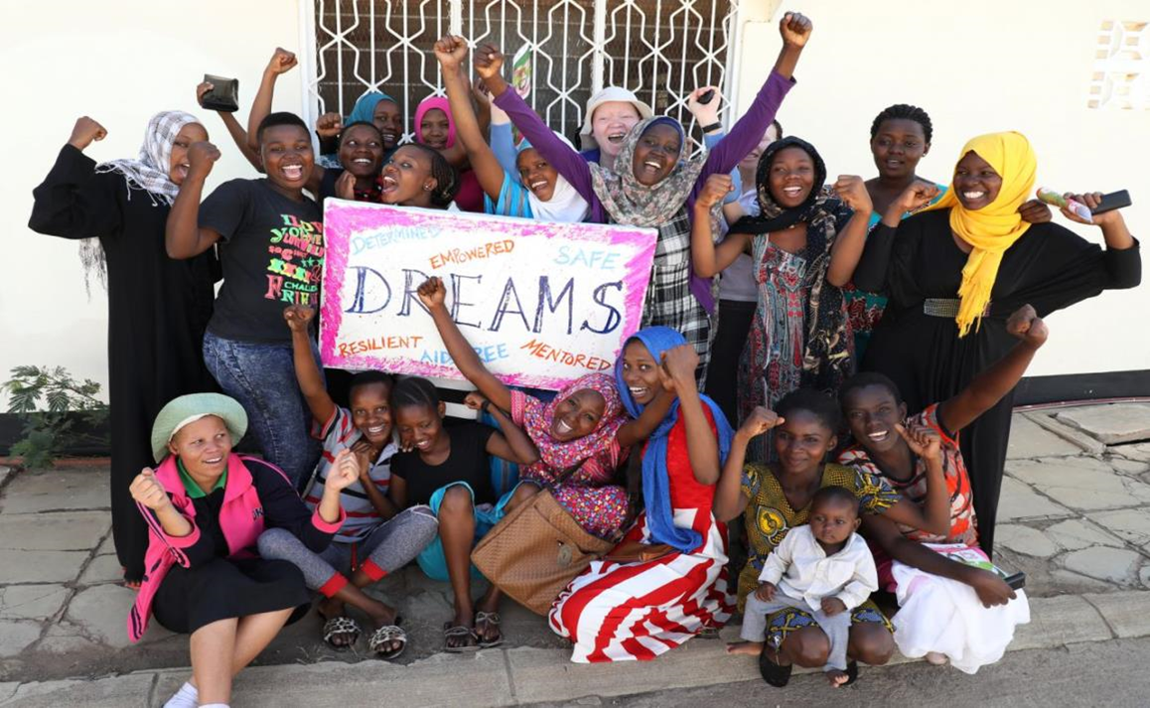
Thank you to the incredible AGYM we are privileged to partner with and our DREAMS teams around the globe

